Slide 1
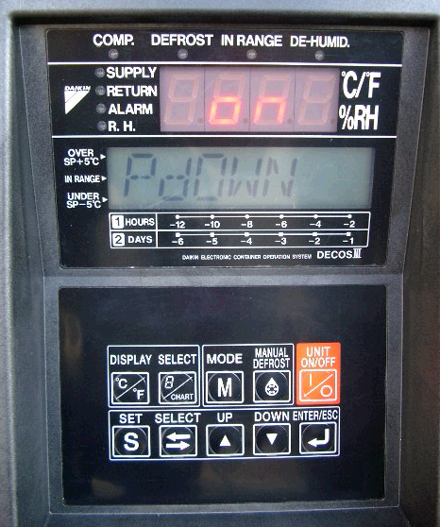
AUTOMATIC PUMP DOWN
SETTING TO AUTO. PUMP DOWN
DURING
OPERATION
COMPLETED
OFF
ON
GOOD
PDOWN
P DOWN
P DOWN
P DOWN
① Press M key twice.
② Select “ON” by using
△ or ▽ key
③ Determine the “ON”
by using Enter key.
④ Switch OFF
and turn circuit
breaker OFF.

Slide 2
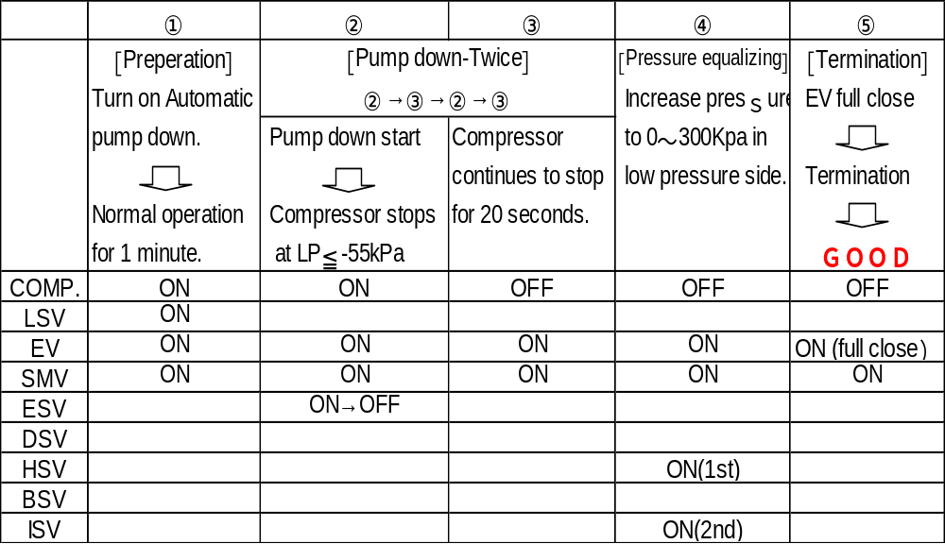
OPERATION

Slide 3
AUTOMATIC PUMP DOWN
Refrigerant collected line after automatic pump down operation
Evaporator
EV
Reheat Coil (option)
BSV
RSV
DSV
HSV
ESV
Drier
Check valve
DPR
Condenser
LSV
SMV BSV
Receiver
ISV
Compressor

